Slide 1
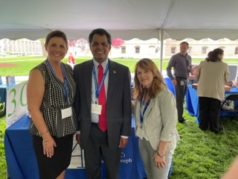
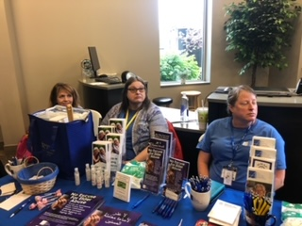
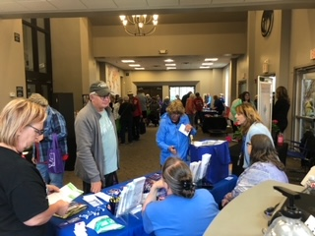
2022 Area Agency on Aging IIIC Community Needs Assessment
Laura Sutter, AAA Director

Slide 2
Population Changes
Indicator | AAA 2014 | AAA 2020 | Projections for 2040
AAA Total Population | 104,679 | 104,481 | 103,257
% Population Over 65 Years | 16% | 18.6% | 19.1%
% Males Over 65 Years | 14.7% | 16.8% | 17.2%
% Females Over 65 Years | 18.5% | 20.4% | 21%
Notes:
While the total population for the AAA 3 C region is expected to decrease by 3% during the next 30 years, the percentage of those 65 years and older is expected to increase by nearly 4%. Males and females are expected to see increases of over 4 percentage points. The largest growth will be in the 75 years and older group which is projected to see a 55% growth during this period. This will impact the services and the types of professionals needed within out communities. **********

Slide 3
Population breakouts
According to the Michigan Department of Health and Human Services Vital Records for 2020 population data:
Indicator | Branch | St. Joseph | AAA 3C
Total Population | 43,517 | 60,964 | 104,481
% Population Over 60 Years | 25.9% | 25.4% | 25.6%
% Males Over 60 Years | 47.4% | 46.8% | 47.4%
% Females Over 60 Years | 52.6% | 53.2% | 52.6%
% Over 60 Years - White | 26.6% | 25.9% | 26.2%
% Over 60 Years - African American | 8.3% | 14.6% | 12.3%
% Over 60 Years - American Indian | 11.3% | 16.9% | 14.8%
% Over 60 Years - Asian | 13.9% | 24.1% | 19.6%
% Over 60 Years - Hispanic | 5.8% | 4.9% | 5.1%
Notes:
This slide shows the population distribution of Branch and St. Joseph Counties for those 60 years and older. In each county the population over the age of 60 years makes up 23.1% - or almost 1 out of every 4 people. There are slightly less males than females, which is not surprising as the average age of widowhood is 55 years.
White is the predominant race – with 95% of the county being white. Both white males and females tend to have a longer life expectancy than other racial and ethnic groups.
For example, the average life expectancy for a white male in Michigan is 74.91 / black males is 66.32
The average life expectancy for a white females is 79.71 / black females is 73.50
There may also be some migration that is occurring as well. *****************

Slide 4
SURVEY BASICS
The 2022 AAA IIIC Needs Assessment was conducted both in paper form and electronically.
Two Survey Monkey electronic surveys were posted: one for Key Community Leaders and Service Providers and one for Older Adults/Caregivers. Surveys were accessed by going to the following URLs:
https://www.surveymonkey.com/r/AAA3CNeedsAssessment
and
https://www.surveymonkey.com/r/AAA3CKeyCommunityLeader
In addition, paper surveys were distributed through multiple direct service providers and via input forum events in both counties. All surveys were input by AAA staff, or via the telephone with the respondent.
The survey was opened for six weeks (April 1st to May 13th) and promoted through the health department’s website, news media and through various email lists.
Respondents were assured that their survey responses were anonymous.
Notes:
Our process was very similar to previous assessments.

Slide 5
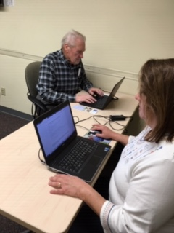
SURVEY BASICS
In total, 269 surveys were completed by both providers/community leaders and older adults/caregivers:
Consumers (Older adults/Caregivers) – 213
Branch County – 78
St. Joseph County – 119
Other - 16
Providers (Key Community Leaders) – 56
Branch – 30
St. Joseph – 25
Other - 1
Notes:
2019 –
Consumers – 145
Branch County – 77
St. Joseph County – 66
Other - 2
Providers – 89
Branch – 52
St. Joseph – 31
Other - 6
2022
Consumers – 213
Branch County – 78
St. Joseph County – 119
Other - 16
Providers – 56
Branch – 30
St. Joseph – 25
Other - 1
Compared to 2019, we had a much higher amount of “Consumer” respondents, and a much lower amount of “Provider” respondents.

Slide 6
Survey totals n =269
Notes:
This provides you with a break out of the surveys.

Slide 7
Older adult/caregiver only - RACE/ETHNICITY* n=211 respondents
* Check all that apply

Slide 8
Older adult/caregiver only – Gender n=209 respondents
Notes:
More heavy on women respondents.

Slide 9
Older adult/caregiver only – Education Level n=211 respondents

Slide 10
Older adult/caregiver only – Household Income n=207 respondents

Slide 11
Older adult/caregiver only – have disability n=204 respondents
Notes:
2019:
Disability = 54.4%
No Disability = 45.6%
2022:
Disability = 49%
No Disability = 51%
Decrease of respondents with disabilities

Slide 12
Older adult/caregiver only – a veteran n=208 respondents
Notes:
2019 Survey = 17% of respondents were veterans
Decreased from 17% to 12%

Slide 13
Older adult/caregiver only – Age distribution n=208 respondents
50.5% of Respondents are 75+ years
Notes:
2019: (56.8% of Respondents are 75+)
Under 55: 0.7%
55-59: 1.4%
60-64: 11.2%
65-69: 14.7%
70-74: 14.7%
75-79: 18.9%
80-84: 14.7%
85+: 23.8%
2022: (50.5% of Respondents are 75+)
Under 55: 2.9%
55-59: 4.3%
60-64: 9.6%
65-69: 17.3%
70-74: 15.4%
75-79: 13.9%
80-84: 17.8%
85+: 18.8%

Slide 14
Older adult/caregiver only – living situation n=204 respondents

Slide 15
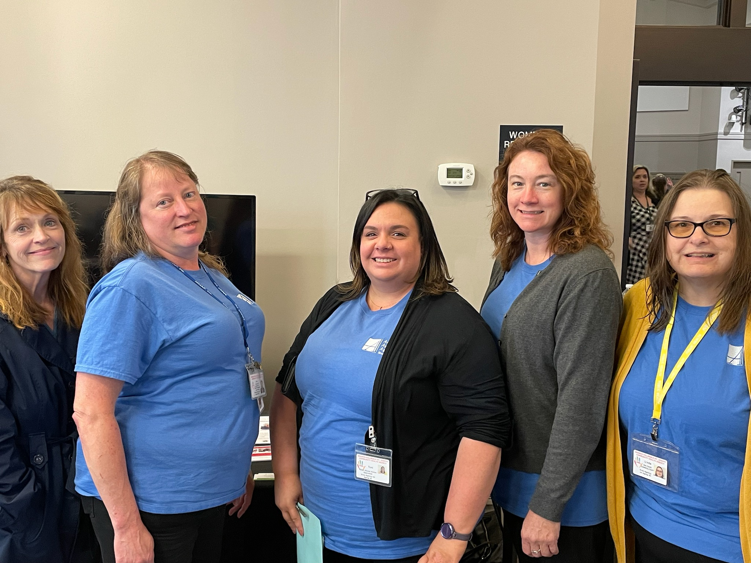
Leading Services and Supports
A list of 25 services and supports were provided. The list was based on the Bureau of Aging, Community Living and Supports list of standardized services.
Respondents were asked to rank them on a four point scale: No Priority/No Funding (1 point); Low Priority (2 points) Medium Priority (3 points); and High Priority (4 Points).
A natural breaking point was observed between those that were highest need and those that were considered lower needs.
Highest overall needs among all respondents ranged between 3.39 and 3.15 and include:
Home Delivered Meals
Transportation within the county
Homemaker Services
Personal Emergency Response System
Care Management/In-Home Assessment & Monitoring
Personal Care
Notes:
2019
Home Delivered Meals
Transportation within the county
MMAP
Personal Emergency Response System
Personal Care
2023
Home Delivered Meals
Transportation within the county
Homemaker Services
Personal Emergency Response System
Care Management/In-Home Assessment & Monitoring
Personal Care

Slide 16
LEADING SERVICES AND SUPPORT NEEDS – Older Adults/Caregivers n= 213 Respondents

Slide 17
LEADING SERVICES AND SUPPORT NEEDS – Community Leaders n= 56 Respondents

Slide 18
Service Expansion Improvements – Older Adults/Caregivers n=213 Respondents
Notes:
Very similar to 2019

Slide 19
Trusted sources of information – Older Adults/Caregivers n=191 Respondents
Notes:
Biggest Increase since 2019: “Internet” – 9%
Biggest Decrease since 2019: “Health Fair/Community Event” – 17%

Slide 20
Have you felt isolated from others since the pandemic started? If so, how often? n= 189 Respondents
Notes:
Almost 60% of respondents have felt isolated some of the time or often/always!

Slide 21
How often do you feel lonely? n= 190 Respondents
Notes:
Over half of respondents feel lonely some of the time or often!

Slide 22
In what ways has the pandemic affected you? n= 137 Respondents
Notes:
Top three ways the pandemic has affected our community: Lack of social opportunities, change in mood, and loss of loved one(s) for both groups of respondents.

Slide 23
Contact & Additional information
For more information regarding the 2022 Needs Assessment, please contact:
Laura Sutter, Director
570 N. Marshall Road
Coldwater, MI 49036
(517) 278-2538 or Toll Free (888) 615-8009
sutterl@bhsj.org
Website: www.bhsj.org/aaa

